Slide 1



SOEN 6441 – BUILD 1 WARZONE GAME
MADE BY TEAM 15-
AMIR ASIF (40290282)
HEEBA SHAIKH (40278184)
JAIWANT SINGH MAHUN (40270569)
MEHAKVEER SINGH (40293616)
PANKAJ KUMAR SHARMA (40269802)
PUNAMKUMAR VEKARIYA (40290462)

Slide 2
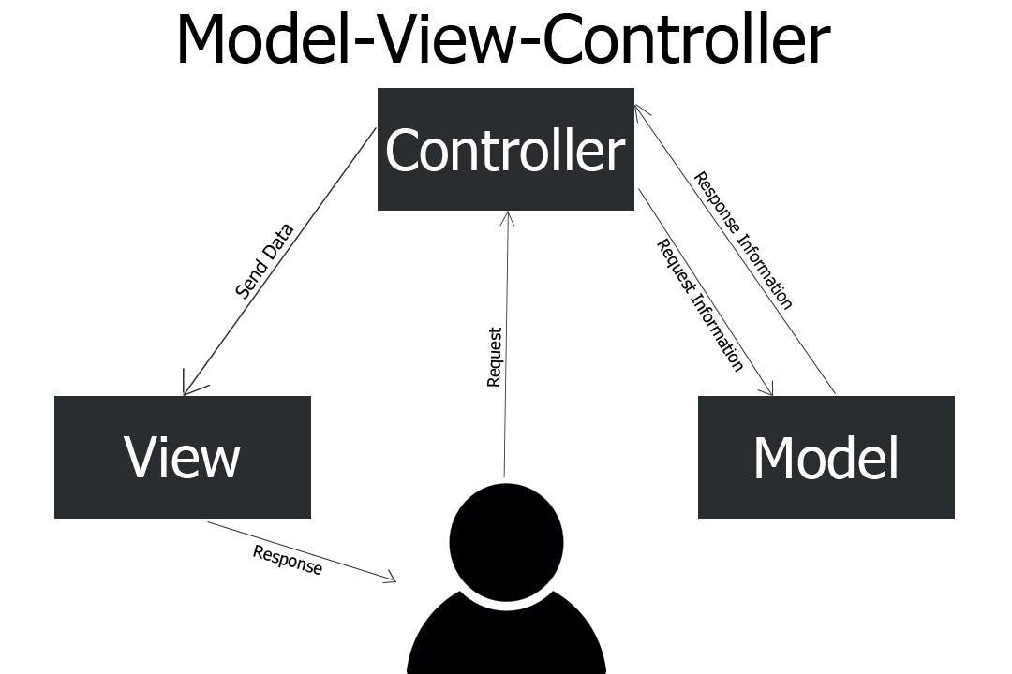
Architectural Design
Model - It represents the business layer of application. It is an object to carry the data that can also contain the logic to update controller if data is changed.
View - It represents the presentation layer of application. It is used to visualize the data that the model contains.
Controller - It works on both the model and view. It is used to manage the flow of application, i.e., data flow in the model object and to update the view whenever data is changed.

Slide 3
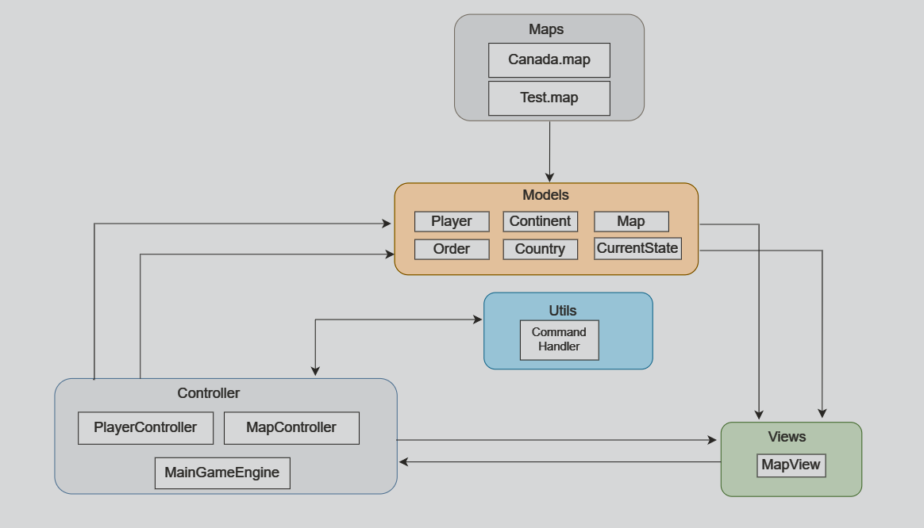
OUR DESIGN

Slide 4
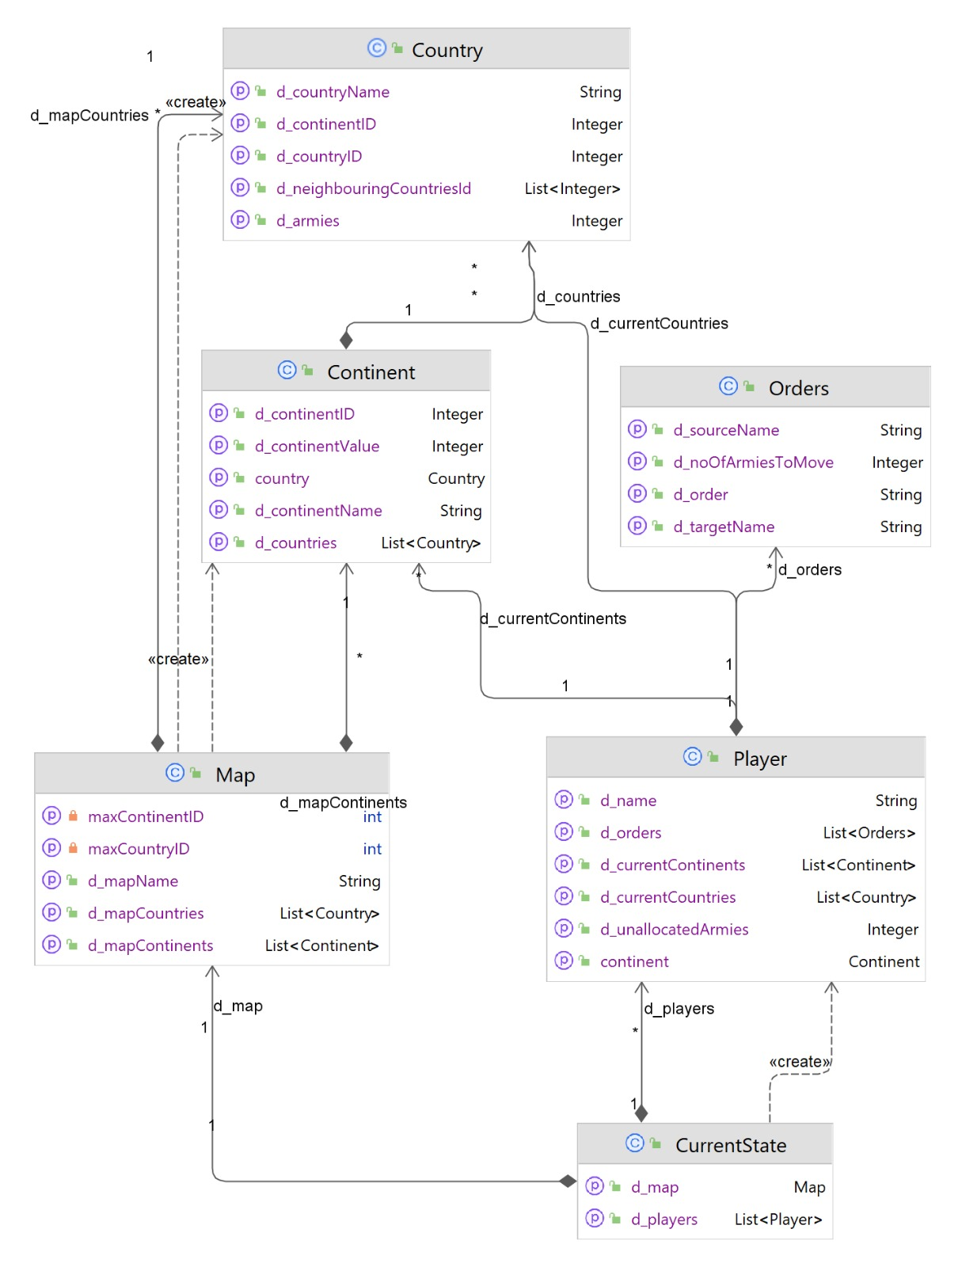
Class diagram

Slide 5
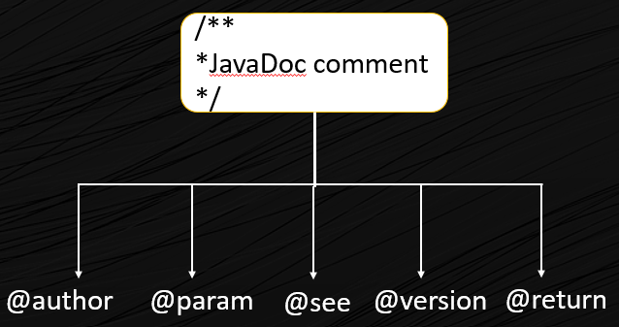
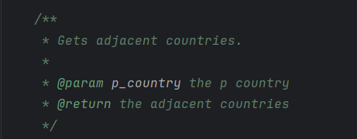
JAVADOCS
It is a document generator tool in Java programming language for generating standard documentation in HTML format. Declarations generates API documentation. It parses the ad documentation in a set of source file describing classes, methods, constructors, and fields.

Slide 6
NAMING COVENTION
Data Members, Member Functions & Methods Parameter
All are in lower camelCase like int addCountryNeighbour (int p_neighbourID)
And data members like int d_countryName
Classes
Class names are in upper CamelCase like MainGameEngine.java
Local Variables
They follow lower camelCase along with "I_." stating it is a local variable like
boolean l_isPresent = true;

Slide 7
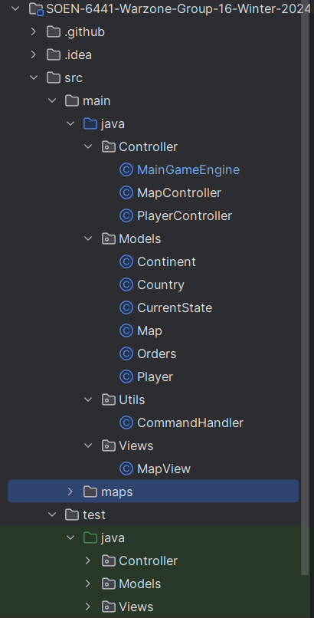
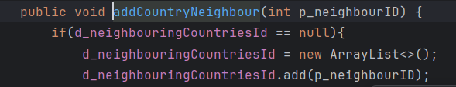
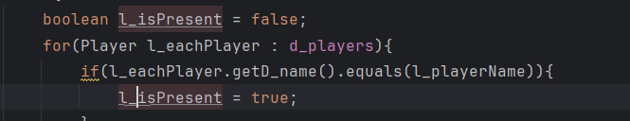
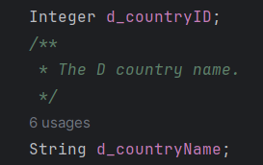
EXAMPLES OF NAMING COVENTION

Slide 8
JuNIT 4
JUnit 4 is a widely used testing framework for Java programming. It allows developers to write repeatable tests for their code, ensuring that the program logic works as expected .
JUnit 4 is a popular testing framework for Java that offers several benefits:
Code Organization: JUnit can help you keep your code organized and easy to read.
Error Detection: JUnit can help you detect and fix errors in your code.
Quality Improvement: JUnit can help you improve the quality of your software.
Efficiency: Junit can help you work more efficiently and improve your testing process.

Slide 9
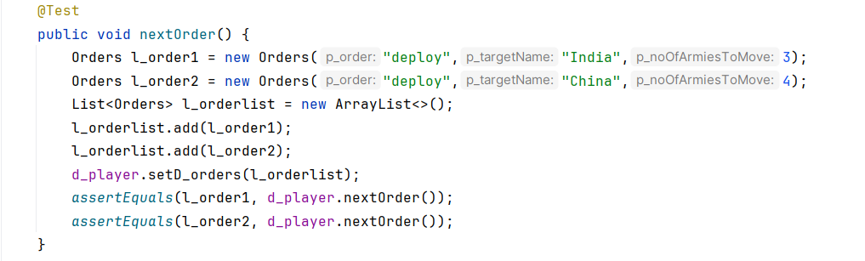
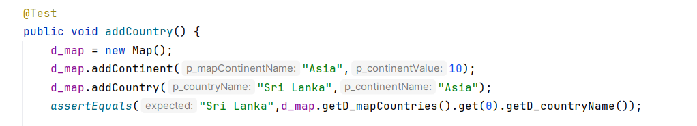
JuNIT TEST CASE EXAMPLES

Slide 10
TEST CASES
Test case Name
(1) Map validation - validateMapIsAConnectedGraphOfCountries()
(2) Continent validation - validateContinentSubgraphConnectivity()
(3) Calculation of number of reinforcement armies.
- getNoOfArmies()
(4) Player cannot deploy more armies that there is in their reinforcement pool. - validateInvalidDeployOrder()

Slide 11

THANKYOU

